Slide 1
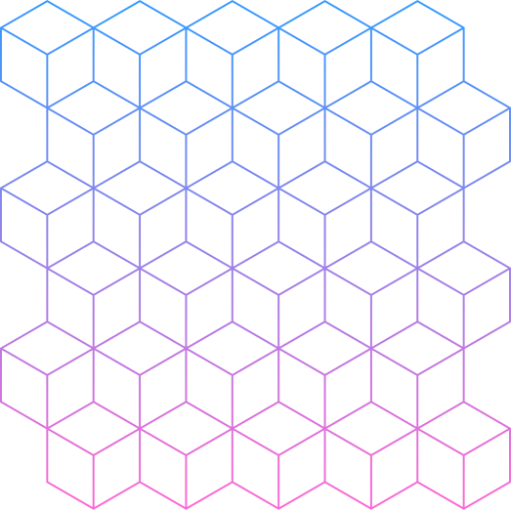
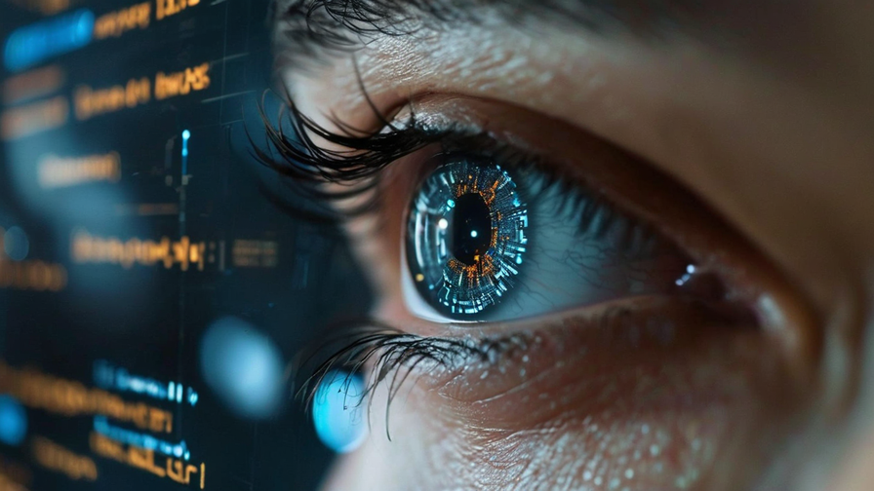
Machine Learning Based Cursor Control Using Eye Movements
Presented by:
Sahil Katkamwar
(33331)
Guided By :
Ms. Jyoti H. Jadhav
Reviewed By :
Dr. Shyam B. Deshmukh

Slide 2
Objectives
01
02
03
Enhance Accessibility
Ensure Precision and Responsiveness
Personalize User Experience
Provide a hands-free cursor control system for individuals with physical limitations or alternative input needs.
Achieve accurate and real-time cursor movements using CNNs and SVMs.
Calibrate the system for individual users and assess performance based on response time and accuracy.

Slide 3
Abstract
Among the new human-computer interaction technologies such as eye tracking and
gesture recognition, the human-computer interaction technology based on eye movements
improves the intelligence, naturalness, and efficiency of human-computer interaction.
This paper investigates the potential of using eye movements to operate a computer
mouse cursor, enhancing accessibility for individuals with physical limitations or those
seeking alternative input methods. By analyzing eye images to detect gaze direction and
eye locations, the feasibility of converting eye movements into cursor actions using
Convolutional Neural Networks (CNNs) and Support Vector Machines (SVMs) is
explored. The research examines the geometric model of an eye-tracking system with a
single camera under natural light, focusing on the optimal placement area of the camera
when the user’s head is stationary and the maximum allowable rotation range when the
user’s head is free to move. Key components include data collection from various user
eye movements, training machine learning models, and real-time processing for precise
cursor control. This paper aims to advance the development of eye-tracking systems that
can offer practical solutions for hands-free computer interaction.

Slide 4
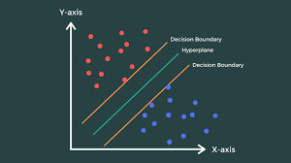
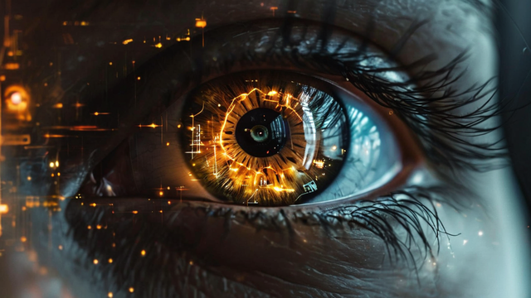
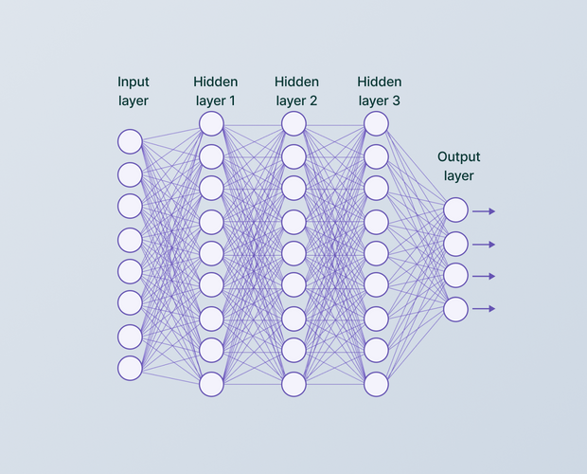
Basic Terminologies
Support Vector Machine
(SVM)
Support Vector Machine (SVM) is a supervised learning algorithm used for classification and regression tasks. It works by finding the optimal hyperplane that maximizes the margin between different classes in the feature space.
Eye tracking measures where and how eyes move, often used to understand visual attention or control devices.
Eye
Tracking
Convolutional Neural Network
(CNN)
A Convolutional Neural Network (CNN) is a deep learning model used to analyze and recognize patterns in images, commonly for tasks like image classification.

Slide 5
Concepts to understand the Topic
Human-Computer Interaction (HCI):
Study of how people interact with computers, focusing on improving usability and accessibility.
Eye Tracking:
Technology that measures eye movement and gaze direction to determine where a person is looking, essential for controlling a cursor with eye movements.
Gaze Detection:
The process of identifying where a person is looking, often used to translate eye movements into cursor actions.
Convolutional Neural Networks (CNNs):
Deep learning models that analyze images, here used for detecting gaze direction and eye locations from eye images.

Slide 6
Concepts to understand the Topic
Support Vector Machines (SVMs):
Machine learning models that can classify gaze direction and assist in interpreting eye movement data for cursor control.
Geometric Modeling:
The mathematical representation of the eye-tracking system, including camera placement and head movement considerations, critical for system accuracy.
Machine Learning:
Training algorithms to learn from data, crucial for interpreting eye movement and controlling the cursor.
Real-Time Processing:
The ability to process and respond to data instantly, important for smooth and responsive cursor control.

Slide 7
Applications
Assistive Technology
AR/VR
Interfaces
Medical Diagnostics
Gaming
Provides hands-free computer control for individuals with disabilities, improving communication and accessibility.
Enables interaction with virtual environments through eye movements, eliminating the need for physical controllers.
Enhances immersive experiences by using eye tracking for aiming and in-game actions.
Aids in diagnosing neurological conditions and monitoring cognitive health through eye movement analysis.

Slide 8
Conclusion
In conclusion, using eye-tracking technology to operate computer cursors has great potential to improve accessibility and engagement in a variety of contexts. This method can enhance immersive experiences in AR/VR environments, enhance gaming interactions, and give accurate and intuitive control to those with physical limitations by incorporating sophisticated machine learning techniques like CNNs and SVMs. Furthermore, its uses in medical diagnostics provide insightful information on the state of the nervous system and cognitive abilities. These developments will spur additional innovation as research moves forward, increasing technology's usability, accessibility, and responsiveness to user requirements.

Slide 9
References
Jingjing Zhou * and Yi Zhu. 2024. Research on the technologies for Human-computer interaction Based on the Eye-tracking. In 5th Interna tional Conference on Computer Information and Big Data Applications (CIBDA 2024), April 26–28, 2024, Wuhan, China. ACM, New York, NY, USA, 5 pages.
Scott A. Stone and Craig S. Chapman. 2023. Unconscious Frustration: Dynamically Assessing User Experience using Eye and Mouse Tracking. Proc. ACM Hum.-Comput. Interact. 7, ETRA, Article 168 (May 2023), 17 pages. i.Jingjing Zhou * and Yi Zhu. 2024. Research on the technologies for Human-computer interaction Based on the Eye-tracking. In 5th Interna tional Conference on Computer Information and Big Data Applications (CIBDA 2024), April 26–28, 2024, Wuhan, China. ACM, New York, NY, USA, 5 pages.
M. S., S. Nirmal, and L. S. Kala, "Eye-Controlled Mouse Cursor," International Journal of Engineering Technology and Management Sciences, vol. 7, no. 3, pp. 1-6, May-Jun. 2023, doi: 10.46647/ijetms.2023.v07i03.051.
i.P. Miah, M. R. Gulshan, and N. Jahan, "Mouse Cursor Movement and Control using Eye Gaze- A Human Computer Interaction," 2022 International Conference on Artificial Intelligence of Things (ICAIoT), Dhaka, Bangladesh, 2022, pp. 1-6, doi: 10.1109/ICAIoT57170.2022.10121742.

Slide 10
References
i.J. Alberto Álvarez Martín, Henrik Gollee, Jörg Müller, and Roderick Murray-Smith. 2021. Intermittent Control as a ModelofMouseMovements. ACMTrans.Comput.-Hum.Interact. 28, 5, Article 35 (August 2021), 46 pages
i.MichalHucko,RobertMoro,andMariaBielikova.2020.ConfusionDetection Dataset of Mouse and Eye Movements. In 28th ACM Conference on User Modeling, Adaptation and Personalization (UMAP ’20 Adjunct), July 14–17, 2020, Genoa, Italy. ACM, New York, NY, USA, 6 pages.
i.V. Shah, P. Punde, S. Dubey, and B. Sonawane, "Mouse Pointer Control Using Eye Movements," JETIR, vol. 6, no. 4, pp. 1-6, Apr. 2019.

